Slide 1
GROUP 4 MIDTERM PROJECT
Professor: Keita Ohshiro
Class: IS665004
Team Members:
Geetha Raja Rajeswari Devi Vegesna
Deva Harsha Nuthakki
Venkata Sai Rahul Sunkari
Naga Vineetha Konakanchi
Airbnb New York 2019

Slide 2
Introduction
Airbnb Newyork 2019 Dataset is curated to provide valuable insights into the bustling hospitality scene of one of the world's most iconic cities. This dataset encapsulates information comprising various attributes related to accommodations listed on the Airbnb within 5 boroughs of NYC with a glimpse into diverse range of lodging options, host characteristics and neighborhood dynamics of short term rentals in the city.

Slide 3
Visualization Objective
The primary objective of visualizing Airbnb NY 2019 is to derive actionable insights and trends that can inform strategic decision-making for various stakeholders, including hosts and guests.
Explore spatial distributions of listings across different neighborhoods and boroughs.
Analyze pricing trends and variations based on location and room type.
Examine temporal patterns in availability and booking frequency throughout the year.
Understand the relationship between the number of reviews, host characteristics, and listing popularity.

Slide 4
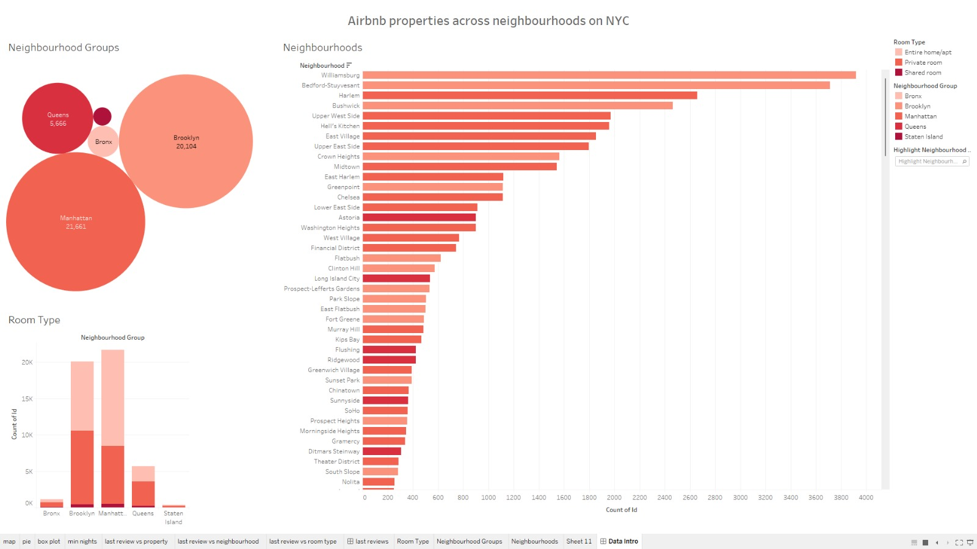
Airbnb Properties across neighborhoods in NYC
The dominance of Brooklyn and Manhattan suggests a significant economic impact, as hosts in these areas contribute substantially to the local economy through tourism-related activities. Understanding the distribution can guide policymakers in managing the impact on neighborhoods and ensuring equitable economic benefits.

Slide 5
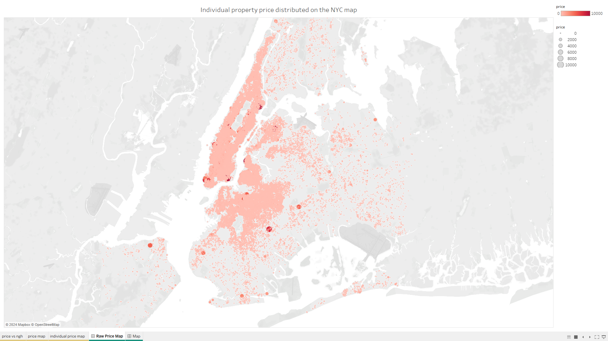
Price density map on individual properties

Slide 6
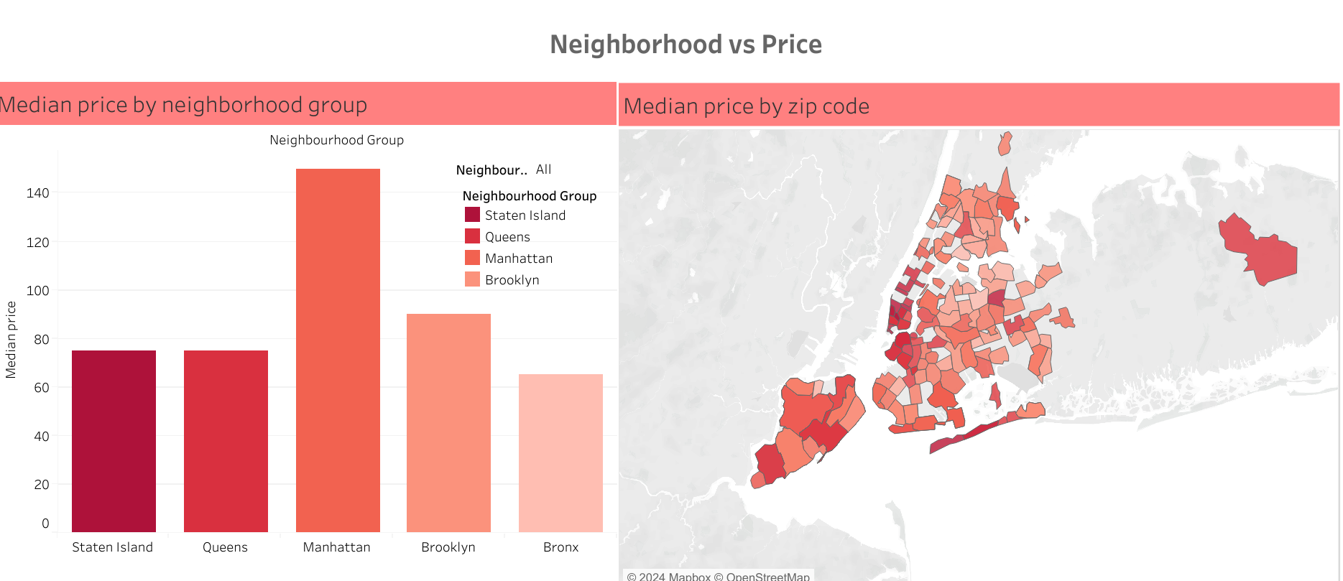
Price by neighborhood type and zip code
Our exploration of median prices by neighborhood groups, enriched with zip code data, provides a dynamic view of New York City's Airbnb market. This comprehensive analysis empowers hosts and guests with valuable insights, fostering informed pricing decisions. As the NYC Airbnb landscape unveils its diverse pricing dynamics, we pave the way for strategic choices that enhance both hosting and guest experiences.

Slide 7
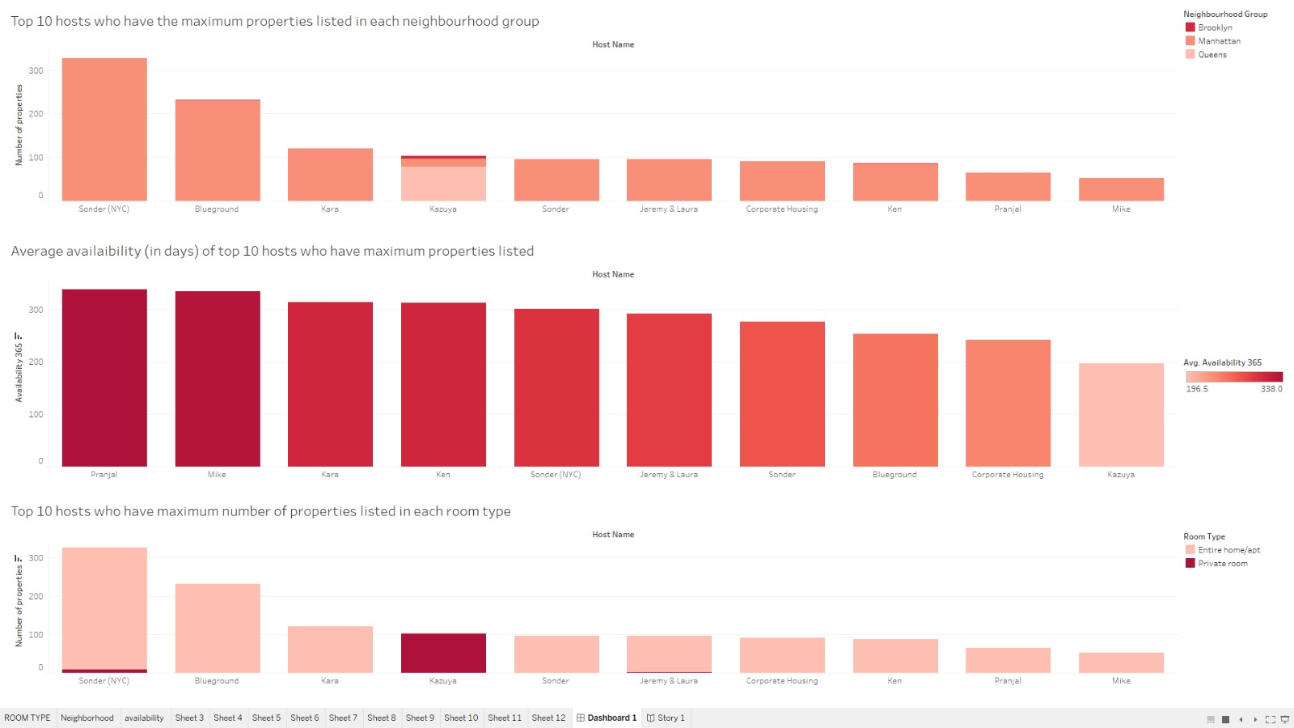
Top 10 hosts who have the maximum properties listed in each neighborhood group
The top graph displays the top 10 hosts who have the maximum number of properties listed in each neighborhood group. The middle graph shows the average availability (in days) of the top 10 hosts who have the maximum properties listed. The bottom graph highlights the top 10 hosts who have the maximum number of properties listed in each room type.

Slide 8
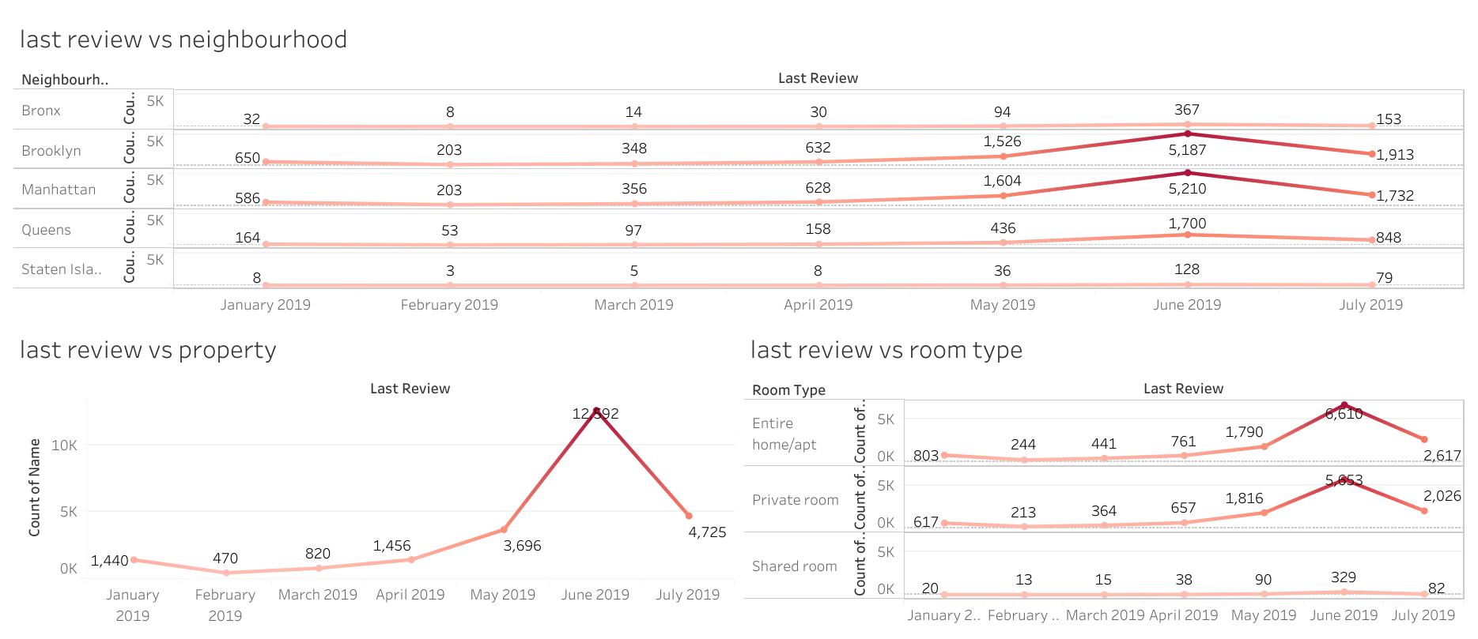
Last Reviews in a Neighborhood group
This dashboard illustrates the count of recent reviews received for properties across five distinct boroughs of New York City. Notably, Brooklyn consistently leads in the number of recent reviews over the observed period. There's a noticeable surge in reviews during May 2019, surpassing 10,000 reviews. Furthermore, entire home/apartment listings received the highest number of recent reviews during this timeframe, with notable peaks in May and June.

Slide 9
Findings
Airbnb Properties across neighborhoods in NYC
Finding: Certain neighborhood groups like manhattan and brooklyn host a higher concentration of Airbnb listings, indicating popularity.
Implication: Hosts can consider neighborhood popularity when setting prices, and guests can explore areas with a diverse range of options.
Location (Neighbourhood) vs Price Map
Finding: Prices vary significantly across different neighborhoods.
Insight: Hosts and guests should consider neighborhood dynamics when setting or evaluating pricing. High-demand or trendy areas may command higher prices.
Top 10 Hosts on Room Types and Neighbourhood Groups
Finding: The top hosts in each neighborhood and room type, illustrated in the three graphs, demonstrate concentrated influence, specialization, and significant property listings.
Insight: For hosts, tailoring strategies to specific neighborhoods and room types can enhance prominence. Guests benefit by understanding these host concentrations, aiding informed decisions based on their preferences and needs.
Last Reviews in a Neighbourhood group
Finding: Distribution of last reviews varies by month.
Insight: Certain months may see a higher concentration of reviews, possibly influenced by seasonal factors or specific events. Hosts can leverage this information for strategic planning.

Slide 10
Conclusion
Neighborhoods significantly influence pricing, revealing a diverse landscape where hosts and guests must navigate varying market dynamics.
Top hosts strategically align their offerings with specific room types and neighborhoods, providing a blueprint for success in the dynamic NYC Airbnb market.
Monthly variations in reviews and last reviews underscore the importance of temporal considerations, guiding hosts to optimize availability and guest satisfaction throughout the year.

Slide 11
Thank You.

